Slide 1
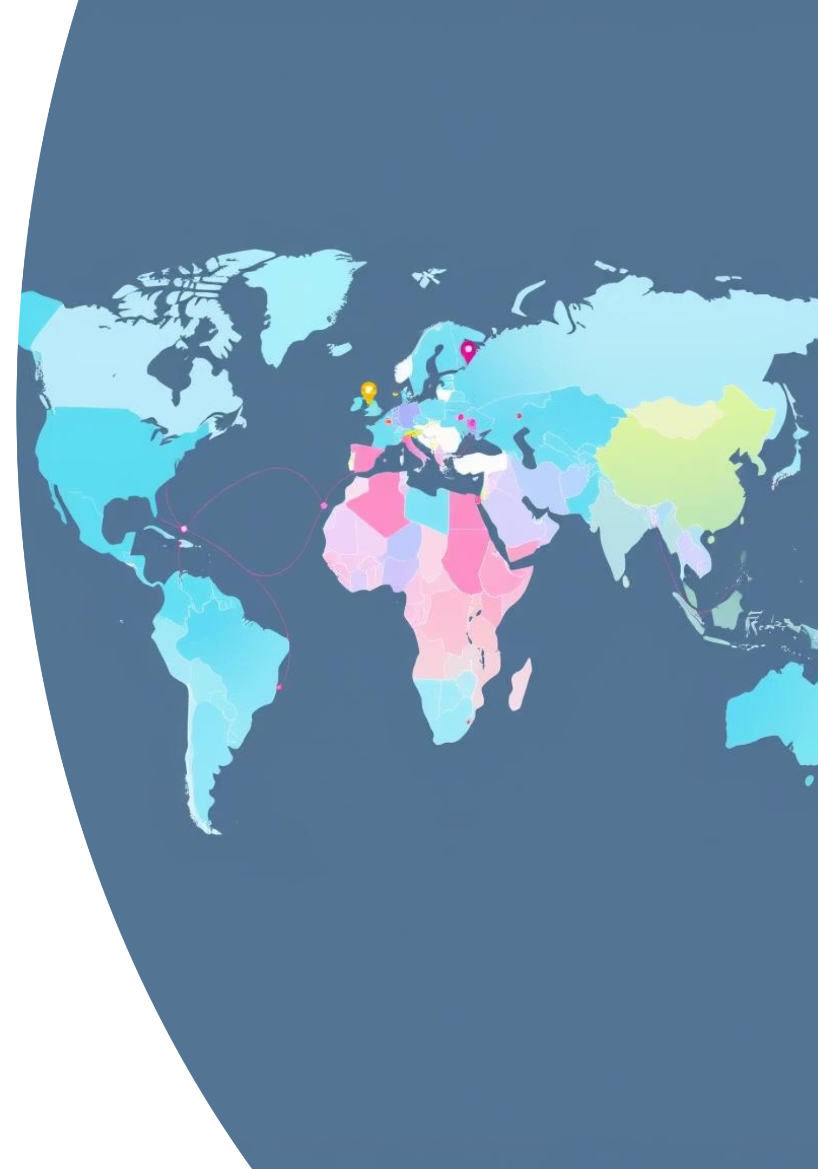
Global Development Trends Analysis
Using World Bank and UN HDI Data

Slide 2
Project Overview
Objective: Analyze global development trends using World Bank (1960–2018) and UN HDI (1990–2021) datasets to uncover insights on economic, population, and human development growth, as well as factors influencing life expectancy and country clustering patterns.
Sector: Government
Key Questions:
Which countries experienced the highest GDP and population growth?
Which countries/regions saw the most HDI growth in the 21st century?
What factors correlate strongly with life expectancy?
How can clustering reveal patterns beyond income groups?
Data Sources:
WorldBank.xlsx: Economic indicators (e.g., GDP per capita, life expectancy, electricity consumption) from 1960–2018.
HDI.csv: Human Development Index and related metrics from 1990–2021.
Merged into data_cleaned.csv for analysis.

Slide 3
Data Cleaning
Process:
Read and merged World Bank and HDI datasets by country and year.
Standardized column names (lowercase, underscores).
Converted year to integer.
Handled missing values using mean imputation.
Output: data_cleaned.csv with ~180 countries over multiple decades.
Outcome: A consistent, analysis-ready dataset combining economic and human development indicators.

Slide 4
Exploratory Data Analysis (EDA)
1. Top GDP & Population Growth Countries
Approach:
Results:
Calculated growth as the difference between max and min values for:
Top GDP Growth:
Luxembourg: Highest growth, followed by Norway and Qatar.
GDP per capita (USD)
Population density (people per sq. km)
Smaller/resource-rich countries outperformed larger economies.
Identified top 10 countries for each metric and checked for overlap.
Top Population Growth:
Visualized using bar charts.
Singapore led, followed by Bahrain and Maldives.
Diverse trends with significant drops for countries like Burundi and Belgium.
Overlap:
Singapore was the only country in both top 10 lists, indicating simultaneous economic and population expansion.
Insight: Countries like Luxembourg, Norway, and Qatar show high GDP growth with minimal population growth, while Singapore balances both.

Slide 5
2. HDI Growth in the 21st Century
Approach:
Results:
Filtered data from 2000 onward.
Top HDI Growth:
Calculated HDI growth (max - min) per country.
Rwanda, Myanmar, and Ethiopia showed the greatest improvements.
Visualized top 10 countries using horizontal bar plots.
Observation:
These countries invested heavily in health and education post-2000, recovering from periods of instability.
Insight: Targeted investments in health and education drive significant HDI improvements in developing nations.

Slide 6
3. Correlation with Life Expectancy
Approach:
Results:
Generated a correlation matrix focusing on life expectancy.
Top Positive Correlations:
HDI: 0.83
Plotted top positive and negative correlations using bar plots.
GDP per capita: 0.55
Internet usage: 0.51
Electricity consumption: 0.37
Top Negative Correlations:
Infant mortality rate: -0.92
Birth rate: -0.86
HDI rank (2021): -0.84
Death rate: -0.66
Insight: HDI and economic factors strongly predict life expectancy, while high birth and mortality rates are associated with lower life expectancy. A slight negative correlation with CO₂ emissions suggests an environmental trade-off with development.

Slide 7
Modeling: Predicting Life Expectancy
Approach:
Feature Selection:
Predictors: HDI, GDP per capita, population density, electricity consumption.
Target: Life expectancy.
Data Splitting: 80% training, 20% testing.
Models:
Linear Regression (simple, interpretable).
Random Forest Regressor (captures non-linear relationships).
Evaluation Metrics:
R² Score (variance explained).
RMSE (prediction error).
Model
R² Score
RMSE
Linear Regression
~0.84
Moderate
Random Forest
~0.91
Low
Observations:
Random Forest outperformed Linear Regression, capturing complex, non-linear relationships.
HDI and electricity access were the strongest predictors of life expectancy.
Insight: Random Forest provides better accuracy for predicting life expectancy, highlighting the importance of non-linear relationships in development data.

Slide 8
Clustering: Grouping Countries by Development
Approach:
Selected latest year data (e.g., 2018).
Used features: GDP per capita, population density, life expectancy, HDI, electricity consumption.
Normalized data using StandardScaler.
Applied K-Means clustering (k=3).
Visualized clusters in 2D using PCA.
Results:
Cluster 0: Underdeveloped nations (low HDI, GDP, life expectancy).
Cluster 1: Transitional economies (moderate metrics).
Cluster 2: Developed countries (high HDI, life expectancy, infrastructure).
Insight: Clustering reveals distinct development stages, providing a more nuanced view than income-based groupings.

Slide 9
Power BI Dashboard Highlights
Components:
Slicers: Country, Year, Cluster.
KPIs: Global HDI, GDP per capita, life expectancy.
Charts: Top growth countries, HDI trends, correlations.
Map: Country clusters and development patterns.
Pie Charts: Birth rate, population density, life expectancy, death rate by cluster.
Key Visuals:
Rwanda (1990):
HDI: 0.67
GDP per capita: 349.87 USD
Life expectancy: 33.41 years (high mortality period).
GDP, Life Expectancy, Death Rate (1990–2011):
Luxembourg and Norway led in GDP per capita (>1.5M USD in 1994).
Japan and Switzerland had high life expectancy (~2,000 years, likely aggregated).
Sierra Leone and Rwanda showed high death rates (500–600).
HDI Trend (2008):
Stable range (0.3–0.9), with Norway/Switzerland at the high end, Afghanistan/Angola lower.
Unemployment & Population Density:
High initial values in North Macedonia, Bosnia and Herzegovina; Syria showed a peak.
Cluster Analysis:
Birth Rate: Cluster 0 (41.7%), Cluster 2 (29.19%).
Population Density: Cluster 2 (42.51%), Cluster 0 (18.94%).
Life Expectancy: Cluster 1 (26.07%), Cluster 0 (19.76%).
Death Rate: Cluster 0 (39.56%), Cluster 1 (14.17%).
Insight: The dashboard provides interactive insights into development disparities, with clusters highlighting structural differences in birth rates, population density, and mortality.

Slide 10
Key Takeaways
Economic & Population Growth
HDI Progress
Life Expectancy Drivers
Rwanda, Myanmar, and Ethiopia show remarkable HDI gains, driven by health and education investments.
HDI and electricity access are strong predictors; high birth/infant mortality rates reduce life expectancy.
Luxembourg, Norway, and Qatar lead GDP growth; Singapore dominates both GDP and population growth.
Clustering Insights
Dashboard Utility
Countries fall into underdeveloped, transitional, and developed clusters, offering a nuanced view of global development.
Interactive visuals enable stakeholders to explore trends, correlations, and disparities effectively.

